Slide 1
Introduction to Computing for Data Analysis
Case study: PageRank (Markov chains on graphs)
Richard Vuduc, Ph.D.
Associate Professor
School of Computational Science and Engineering
Storing sparse matrices
Notes:
So far, you’ve reduced the PageRank computation into one of linear algebra.
In this lesson, we’ll look at one more detail you need to implement it, namely, some options for storing the matrix, which will turn out to be “sparse,” meaning, mostly zero.

Slide 2
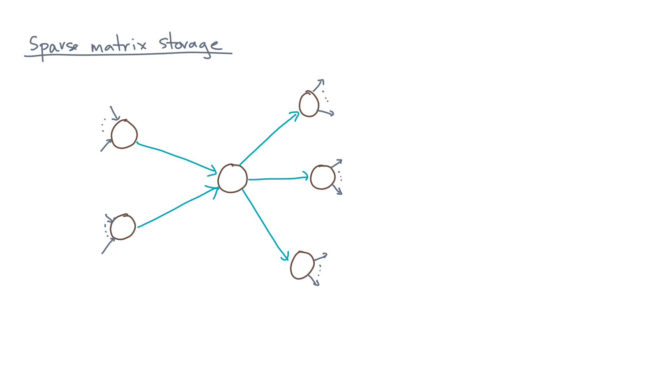
Notes:
Recall the random surfer model.
To each edge, we assigned a transition probability.

Slide 3
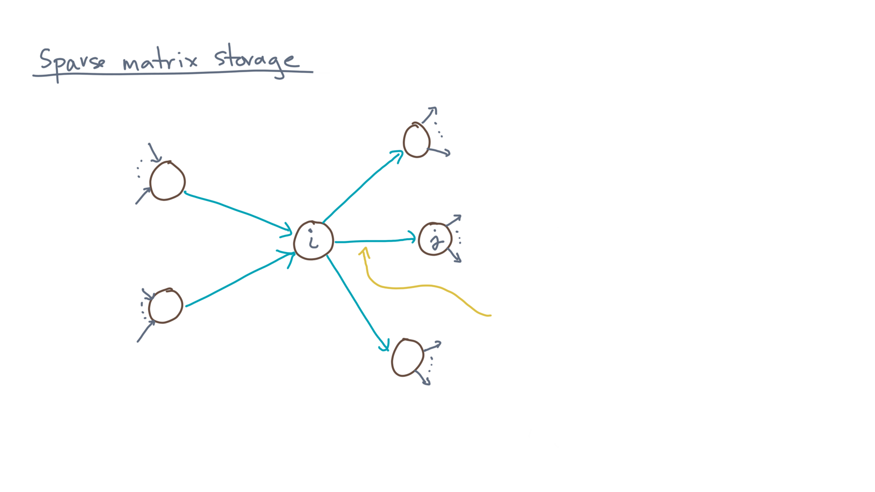
Notes:
That is, consider any edge connecting node “eye” to node “jay.”

Slide 4
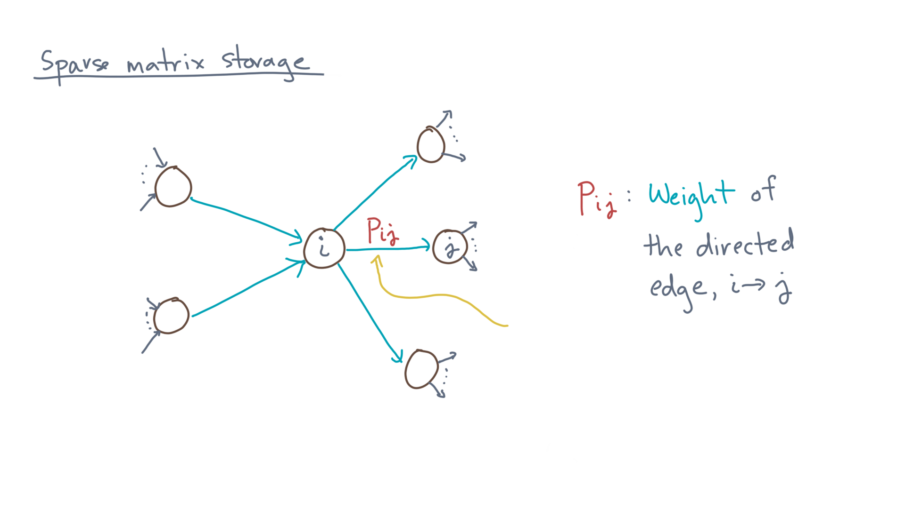
Notes:
We assigned that edge a value, “pee-eye-jay.”
We say this edge is weighted by that value.

Slide 5
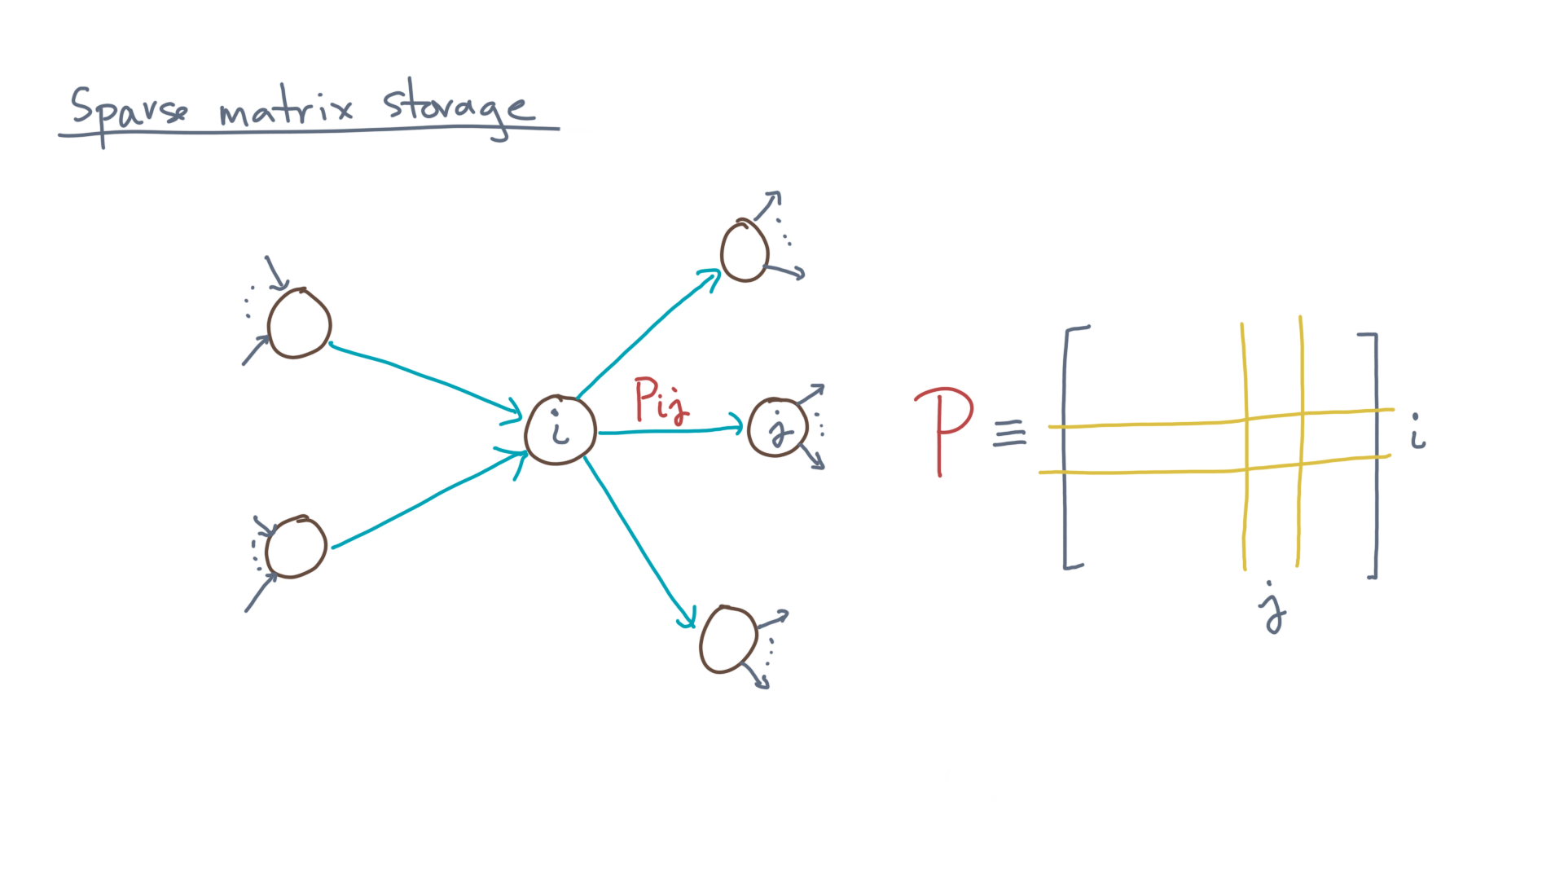
Notes:
You can view the collection of weights as a matrix, “capital-P,” whose eye-jay entry is the weight of edge eye-jay.

Slide 6
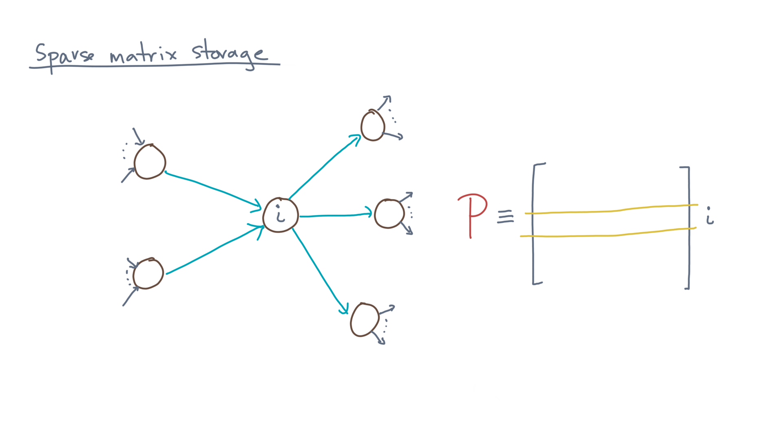
Notes:
Now consider the i-th row of P.

Slide 7
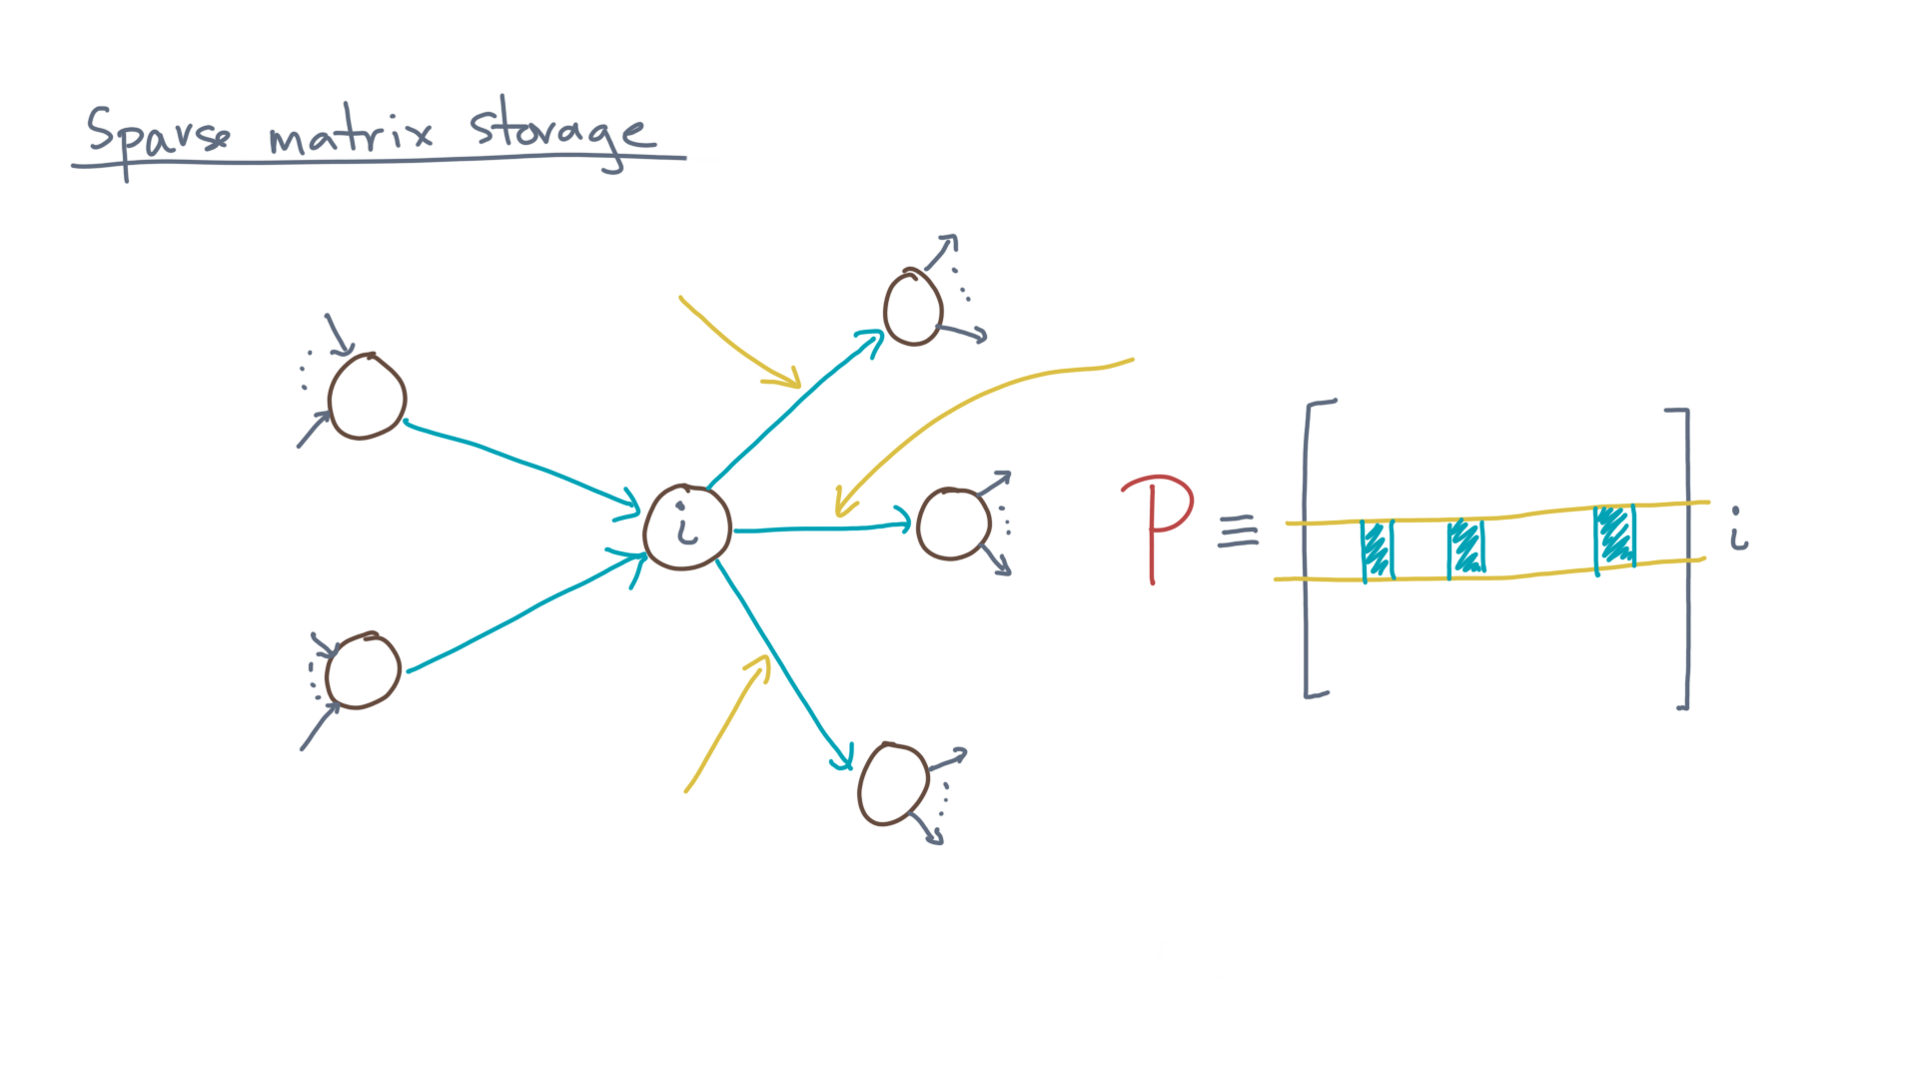
Notes:
It will only have non-zero entries wherever there are edges in the graph.

Slide 8
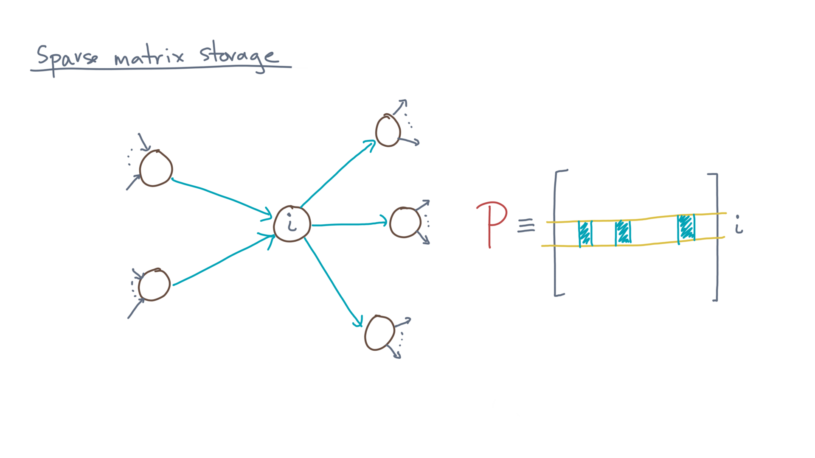

Slide 9
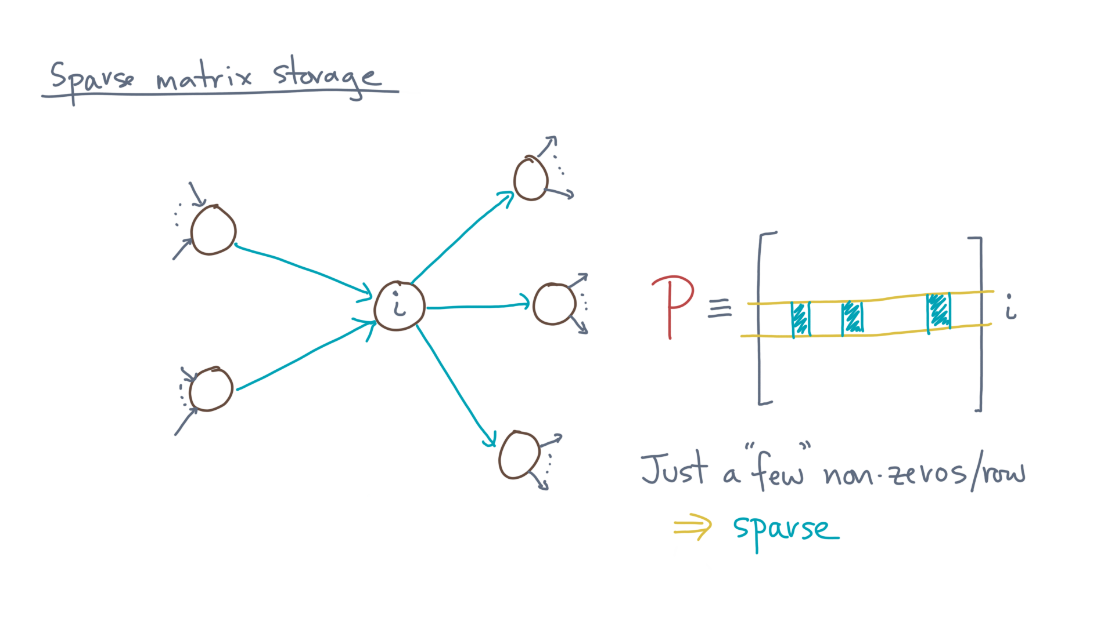
Notes:
In most real-world graphs, the number of non-zeros per row is relative small, meaning the matrix is mostly zero.
In those cases, we say the graph or matrix is “sparse.”
But what is “small?”

Slide 10
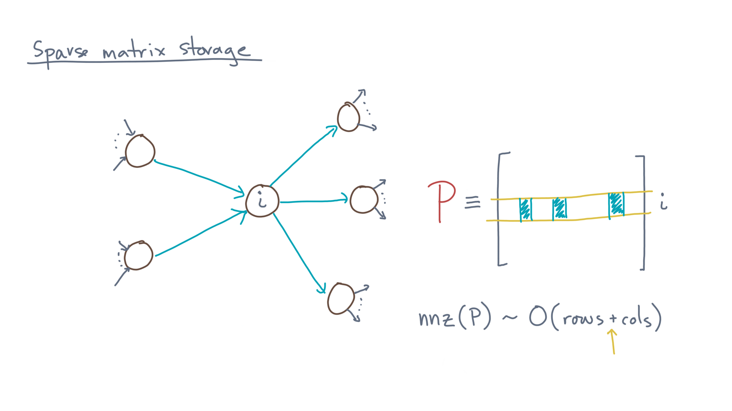
Notes:
Well, sparsity does *not* have a precise definition.
But as a rule of thumb, sparse means the number of non-zeros of the matrix grows like the number of rows *plus* the number of columns.
By contrast, the number of non-zeros in a completely full or *dense* matrix would be the number of rows *times* the number of columns, which might be much larger.

Slide 11
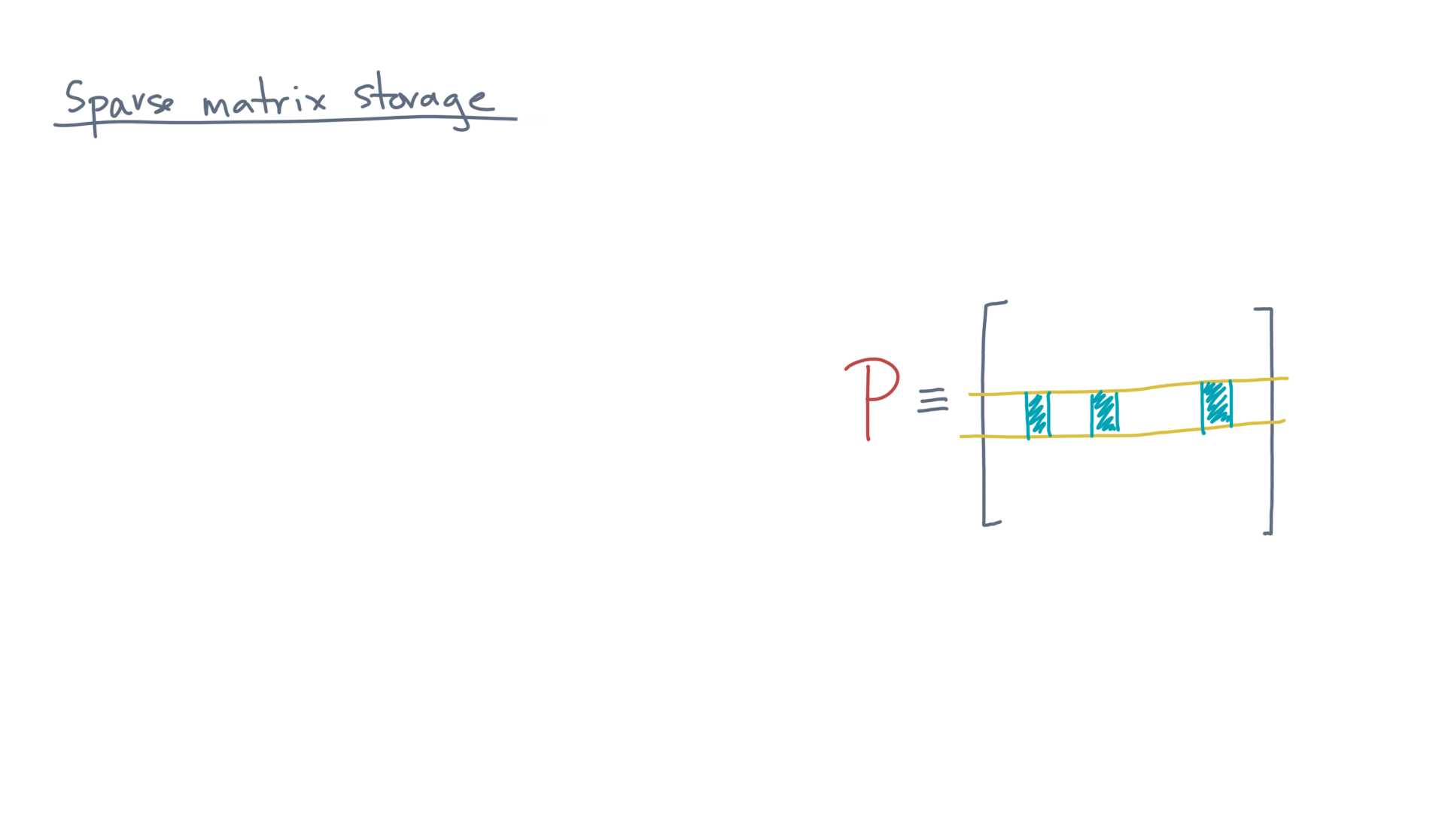
Notes:
Now, when the matrix is sparse, we can store it in a compact way!
There are many options, but here are two common ones.

Slide 12
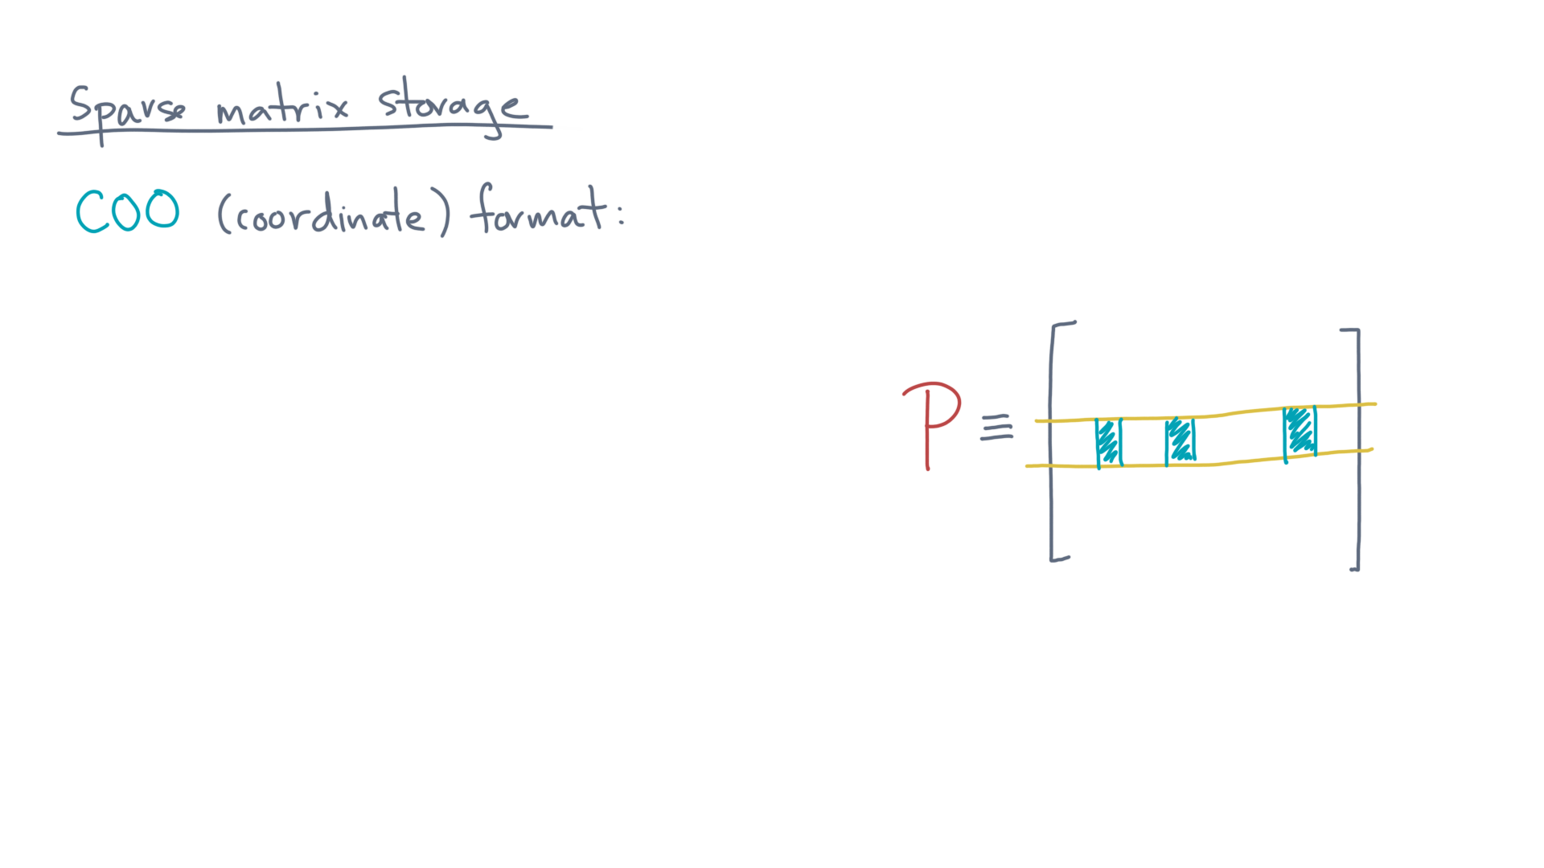
Notes:
The first is called coordinate, or “COO”, format.
The idea is simple.

Slide 13
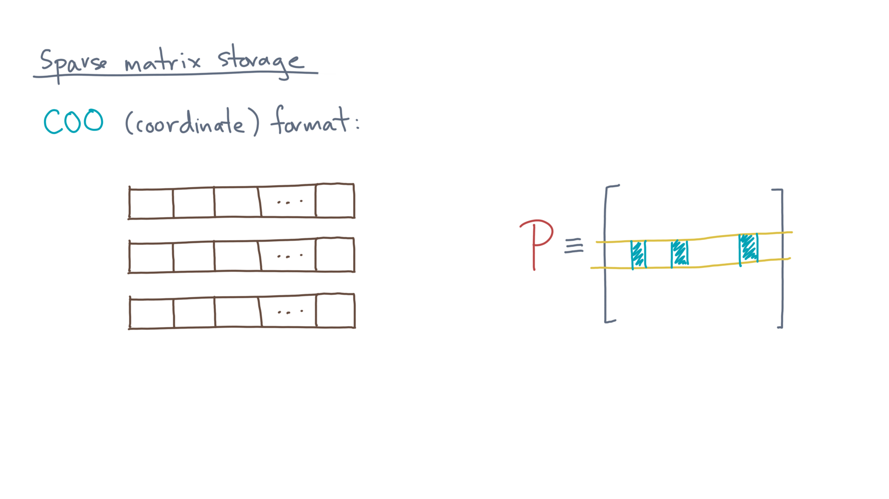
Notes:
Let’s store the matrix using three arrays or lists.

Slide 14
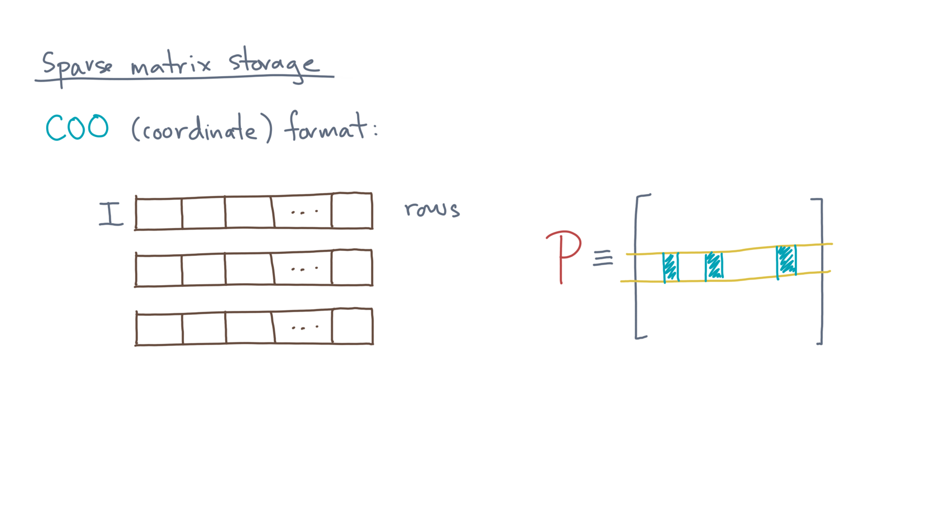
Notes:
One stores the row index of every non-zero – call it, “capital-Eye.”

Slide 15
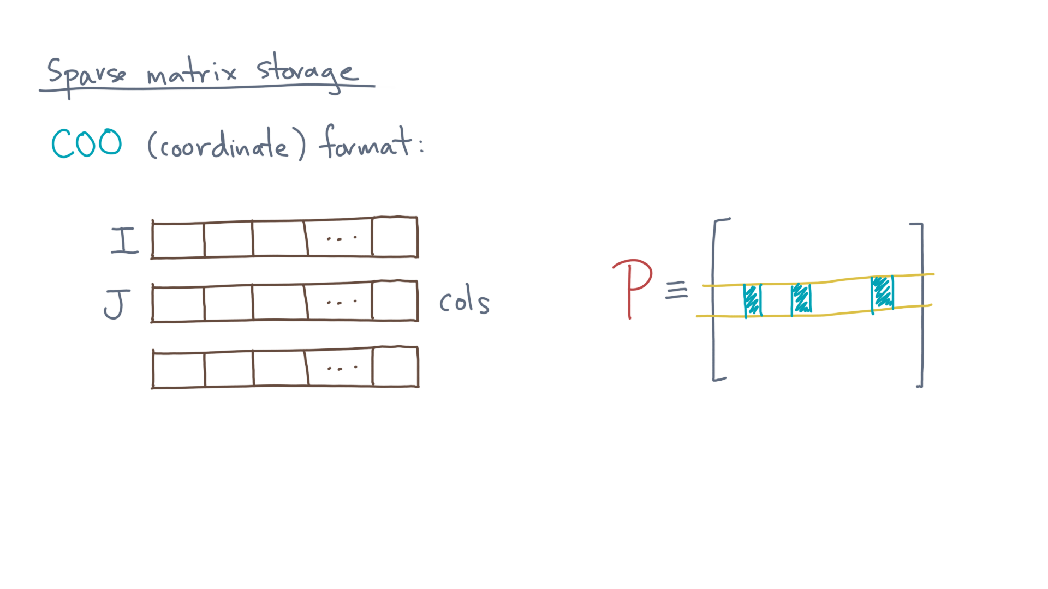
Notes:
Another stores the corresponding column indices. Call it, “capital-Jay.”

Slide 16
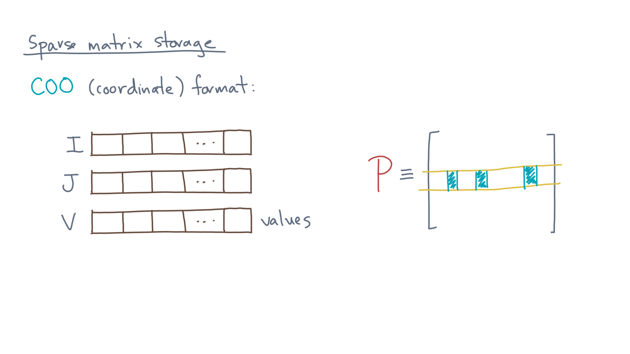
Notes:
The last stores the values.
Call it “capital-Vee.”

Slide 17
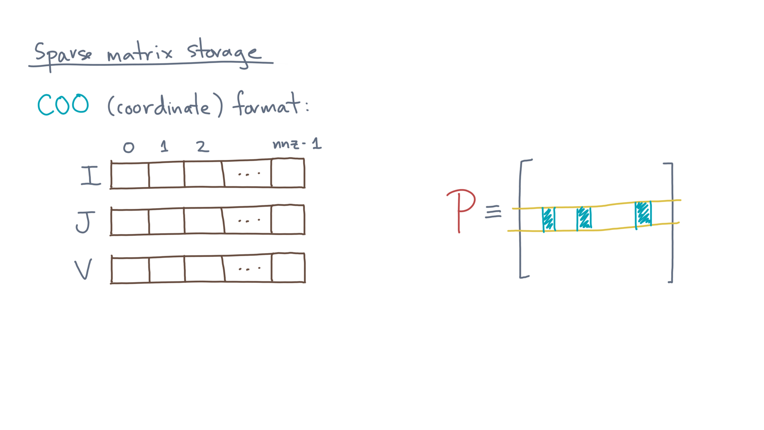
Notes:
By this definition, each array has one entry for each non-zero.
Let’s number the positions by 0 through nnz minus one.

Slide 18
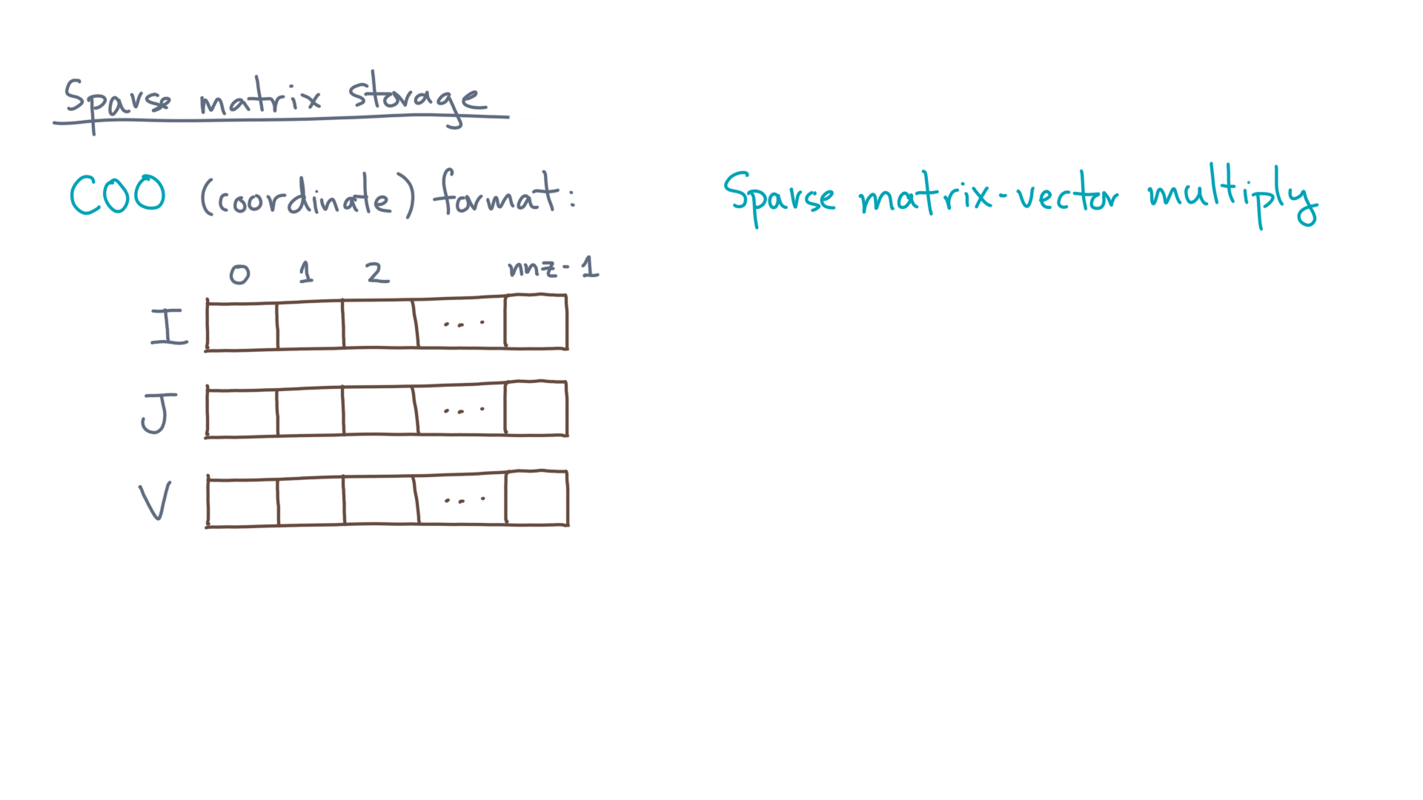
Notes:
Now, suppose you want to multiply a vector by this matrix.

Slide 19
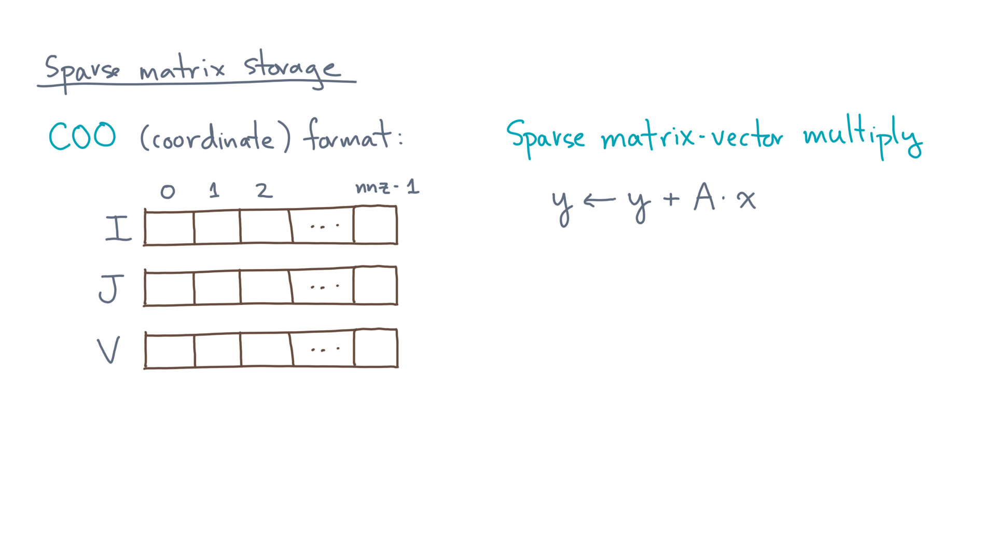
Notes:
That is, given two vectors, x and y, and a matrix A, compute y gets y plus A times x.

Slide 20
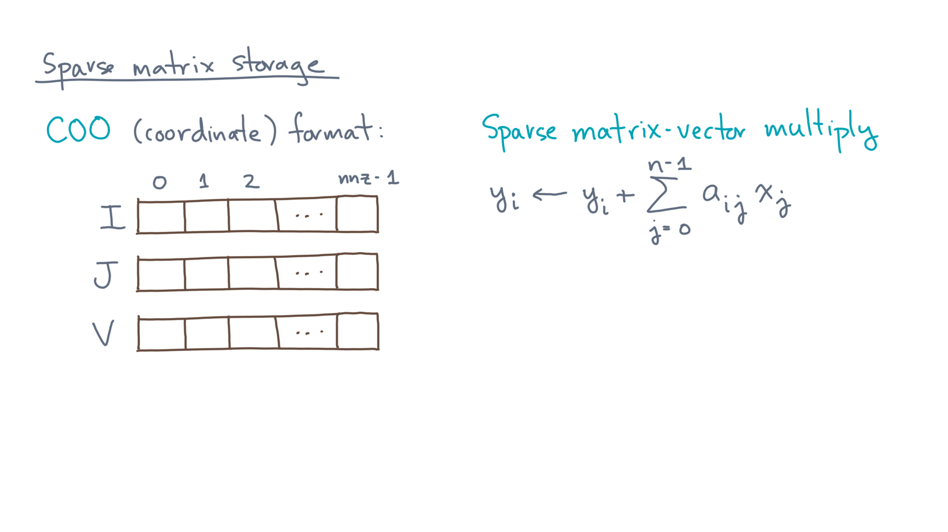
Notes:
In scalar form, for each element of the output, y-eye, you would compute a dot-product between row-eye of the matrix A and the vector, x.
So what does the code look like, given a COO representation of A?

Slide 21
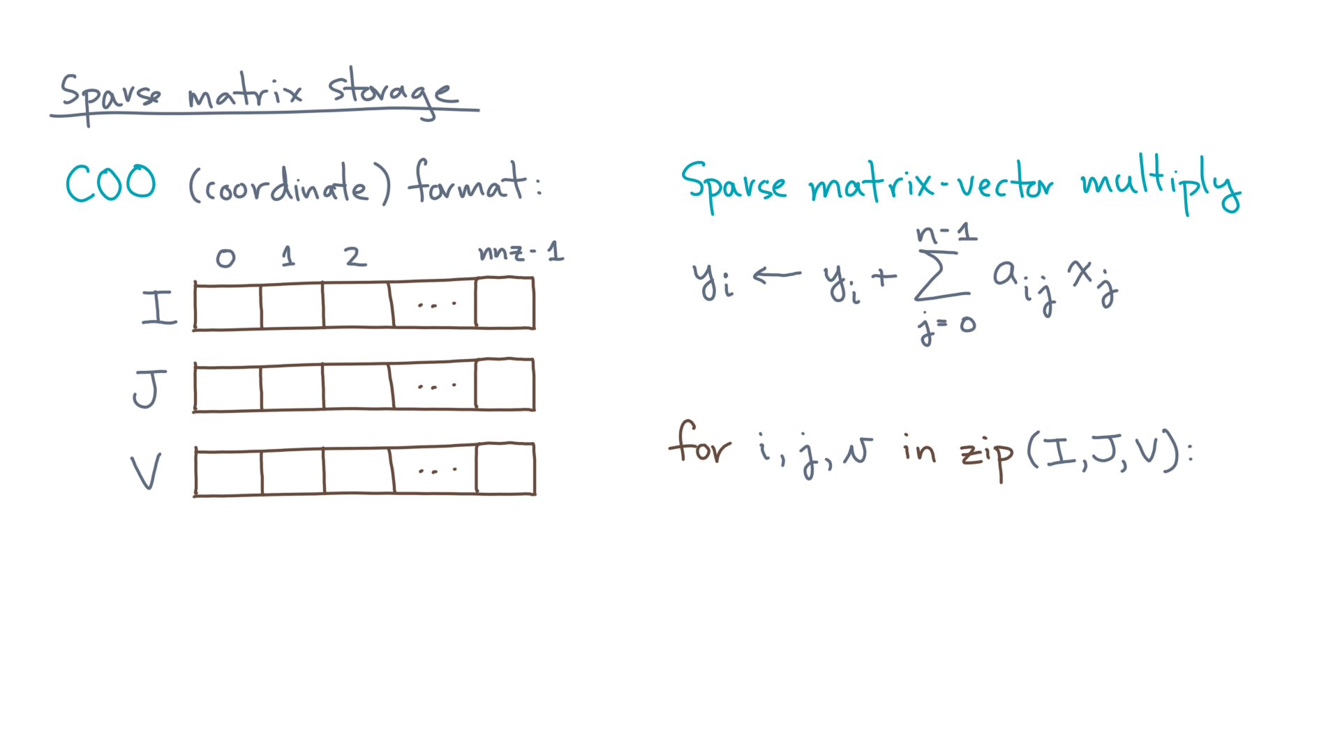
Notes:
You could use a zipper iteration over capital-Eye, capital-Jay, and capital-Vee.
In this code, each non-zero value is little-vee, and its row and column indices are little-eye and little-jay.

Slide 22
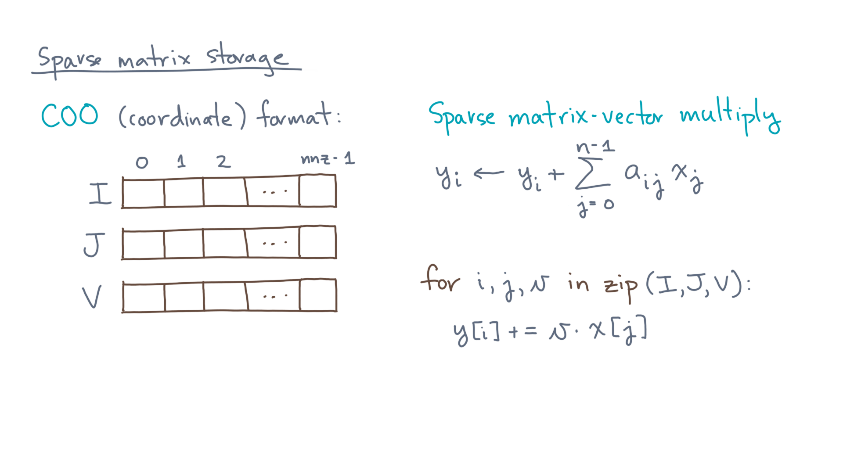
Notes:
The code can then update each y-sub-eye by little-vee times x-sub-jay.
Easy breezy!

Slide 23
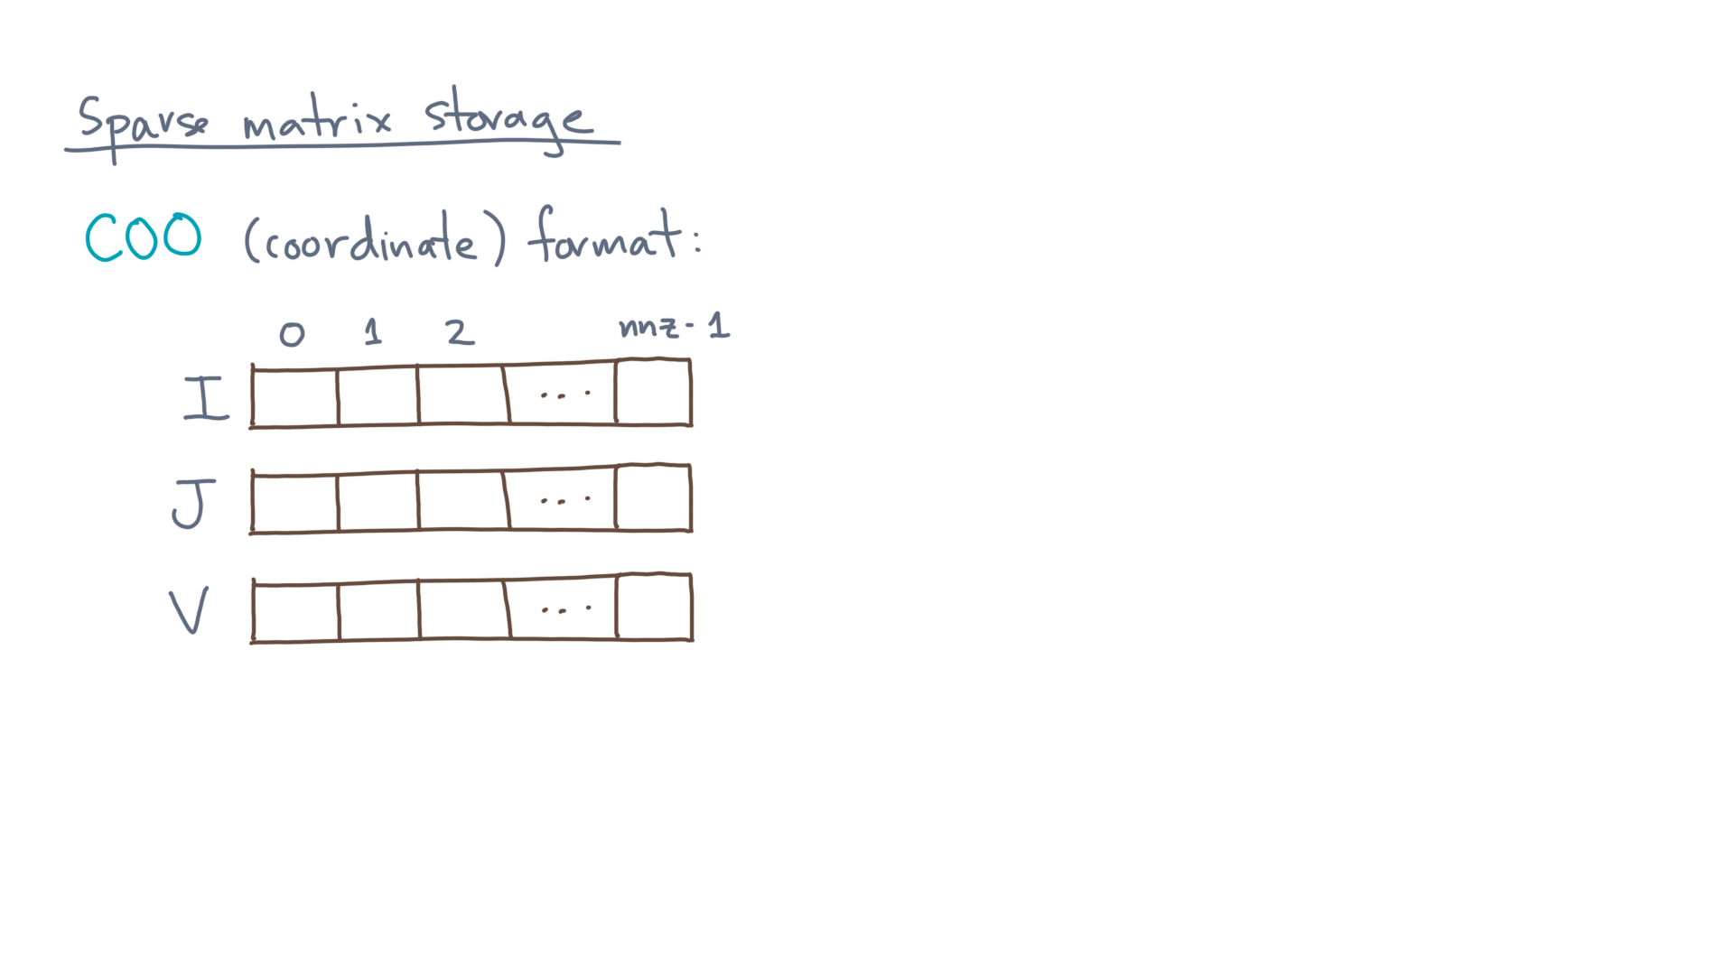
Notes:
Now this format uses more storage than it needs.

Slide 24

Notes:
To see why, recall this picture of the sparse matrix and consider row little-i.

Slide 25
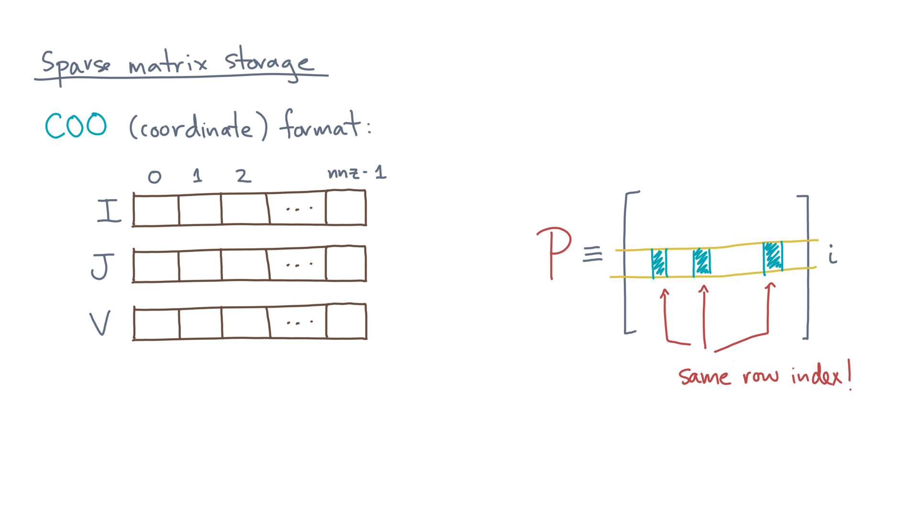
Notes:
All of its elements have the same row index, little-i.

Slide 26

Notes:
That means little-eye might appear several times in the row index array, capital-Eye.
This motivates a different format, called “compressed sparse row” storage.

Slide 27
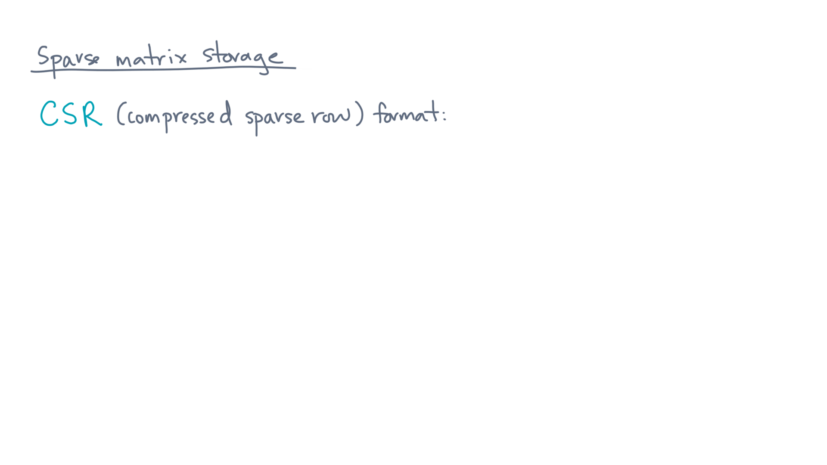
Notes:
Or “CSR” for short.
To see how it works, consider this matrix.

Slide 28
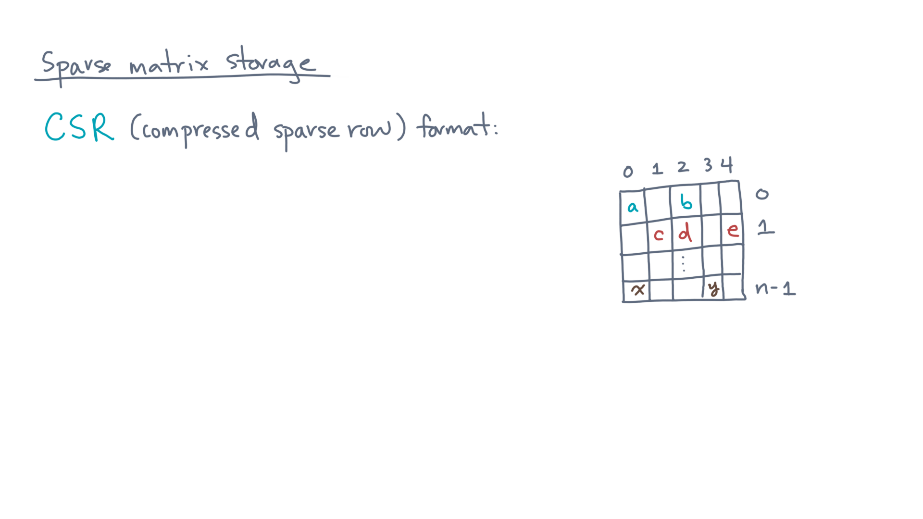
Notes:
It has “en” rows and 5 columns.
Like COO, CSR uses 3 arrays.

Slide 29
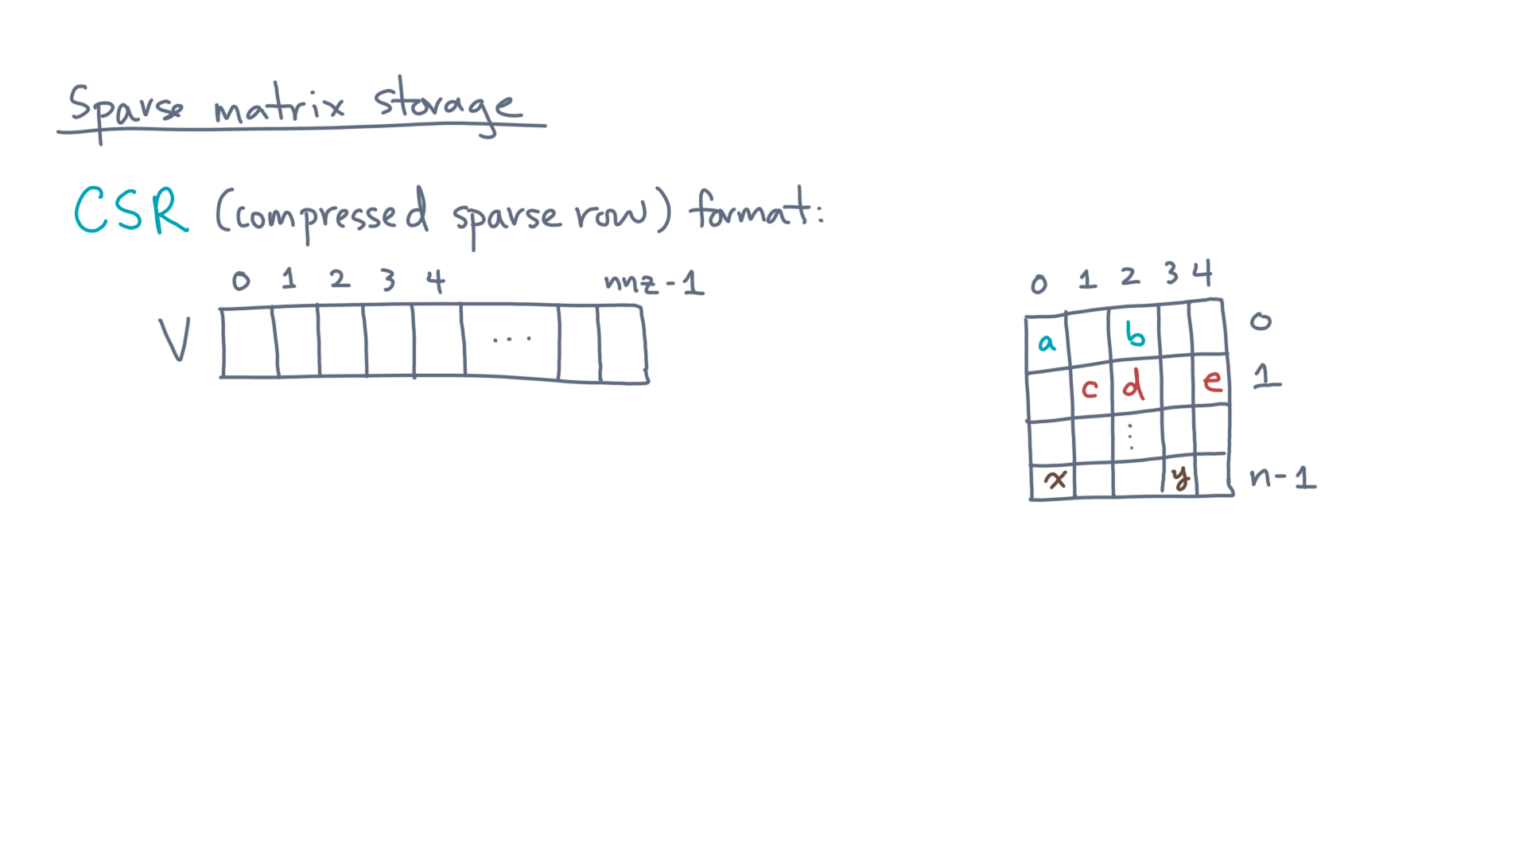
Notes:
The first is an array, “capital-Vee,” which stores the non-zeros.
They are packed together, row-by-row.

Slide 30
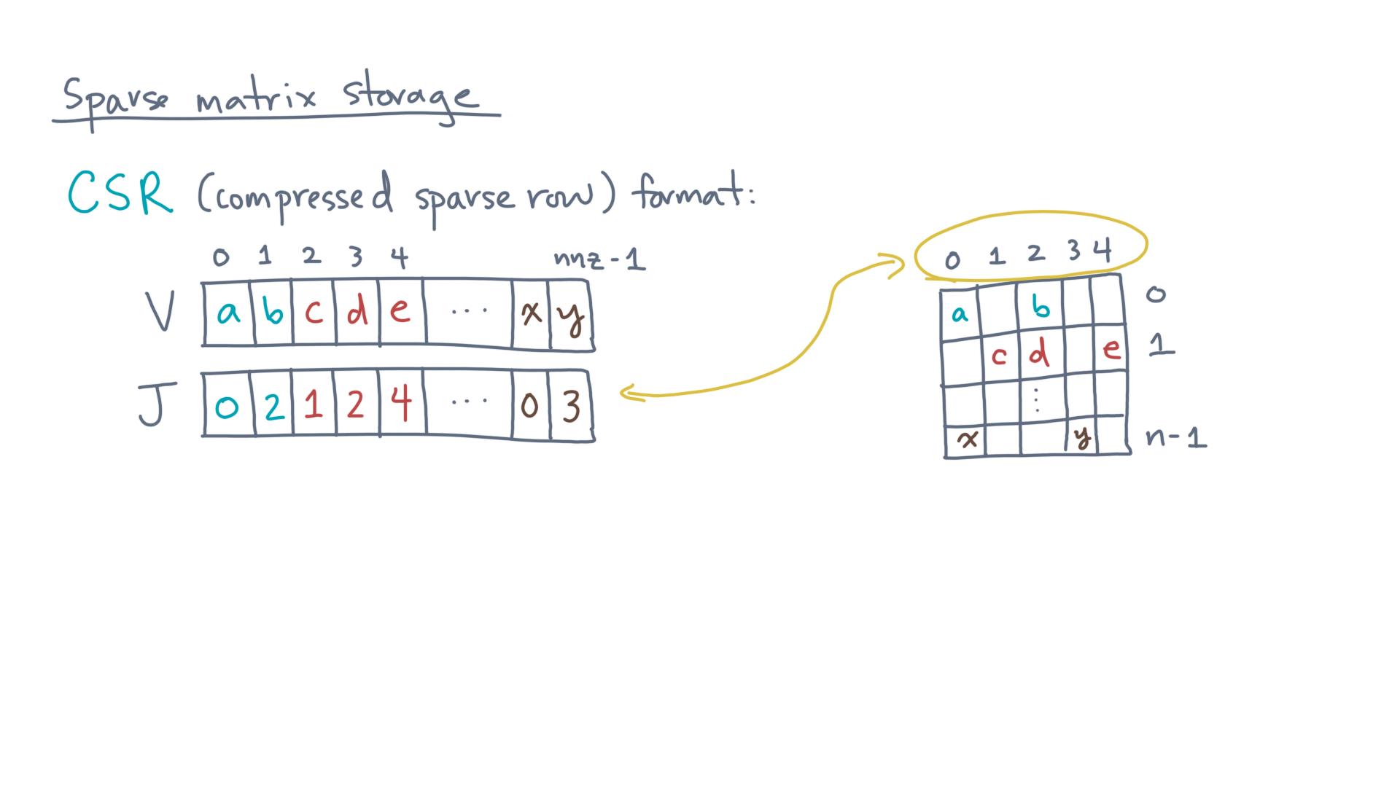
Notes:
The second is an array to hold the column indices.
Call it, “capital-Jay.”
It has the same size as “capital-Vee.”

Slide 31
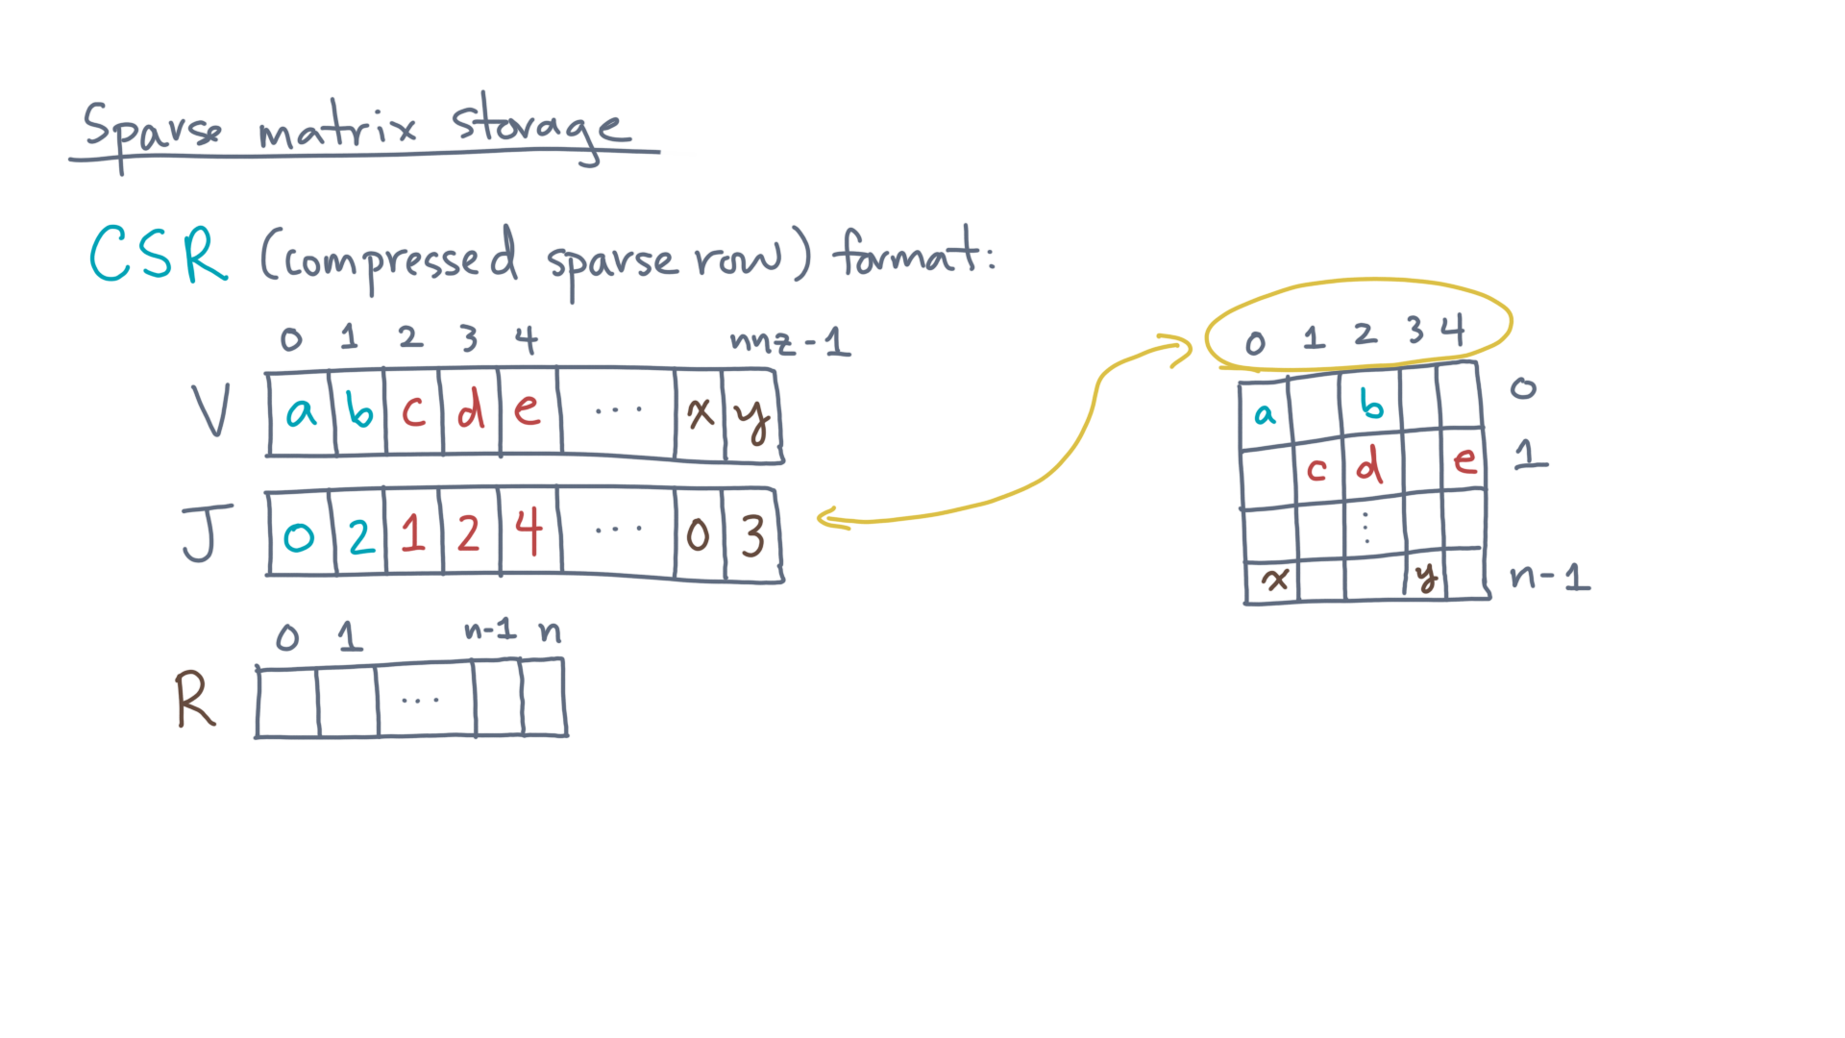
Notes:
The third array holds “row-pointers.”
Call it, “capital-Are.”
Its size is the number of rows, plus one.

Slide 32
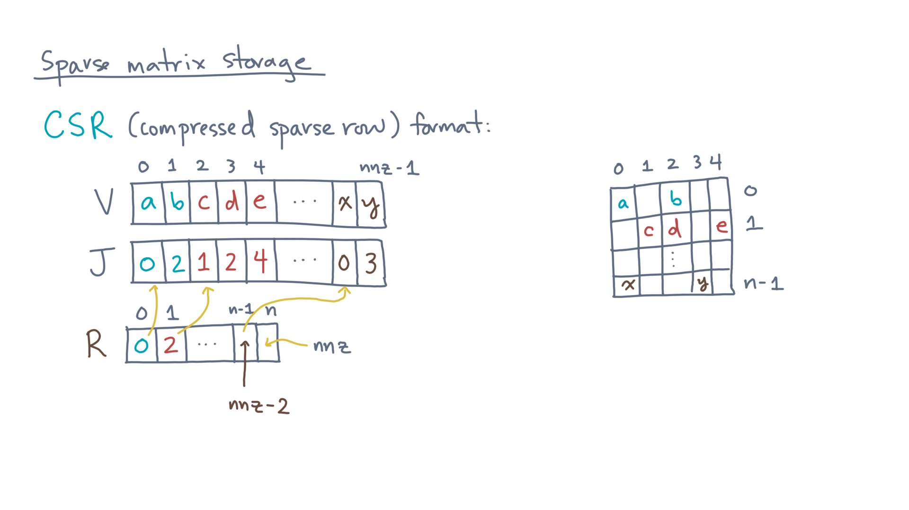
Notes:
For each row, it holds the starting index of that row in the Vee and Jay arrays.
The last element is the number of non-zeros.

Slide 33
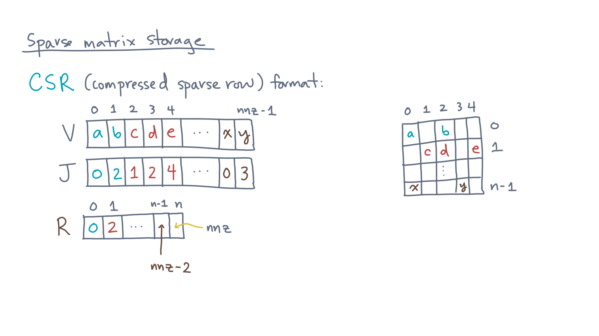
Notes:
In this scheme, if nnz is much larger than n, then CSR saves about one array’s worth of index metadata compared to COO.

Slide 34
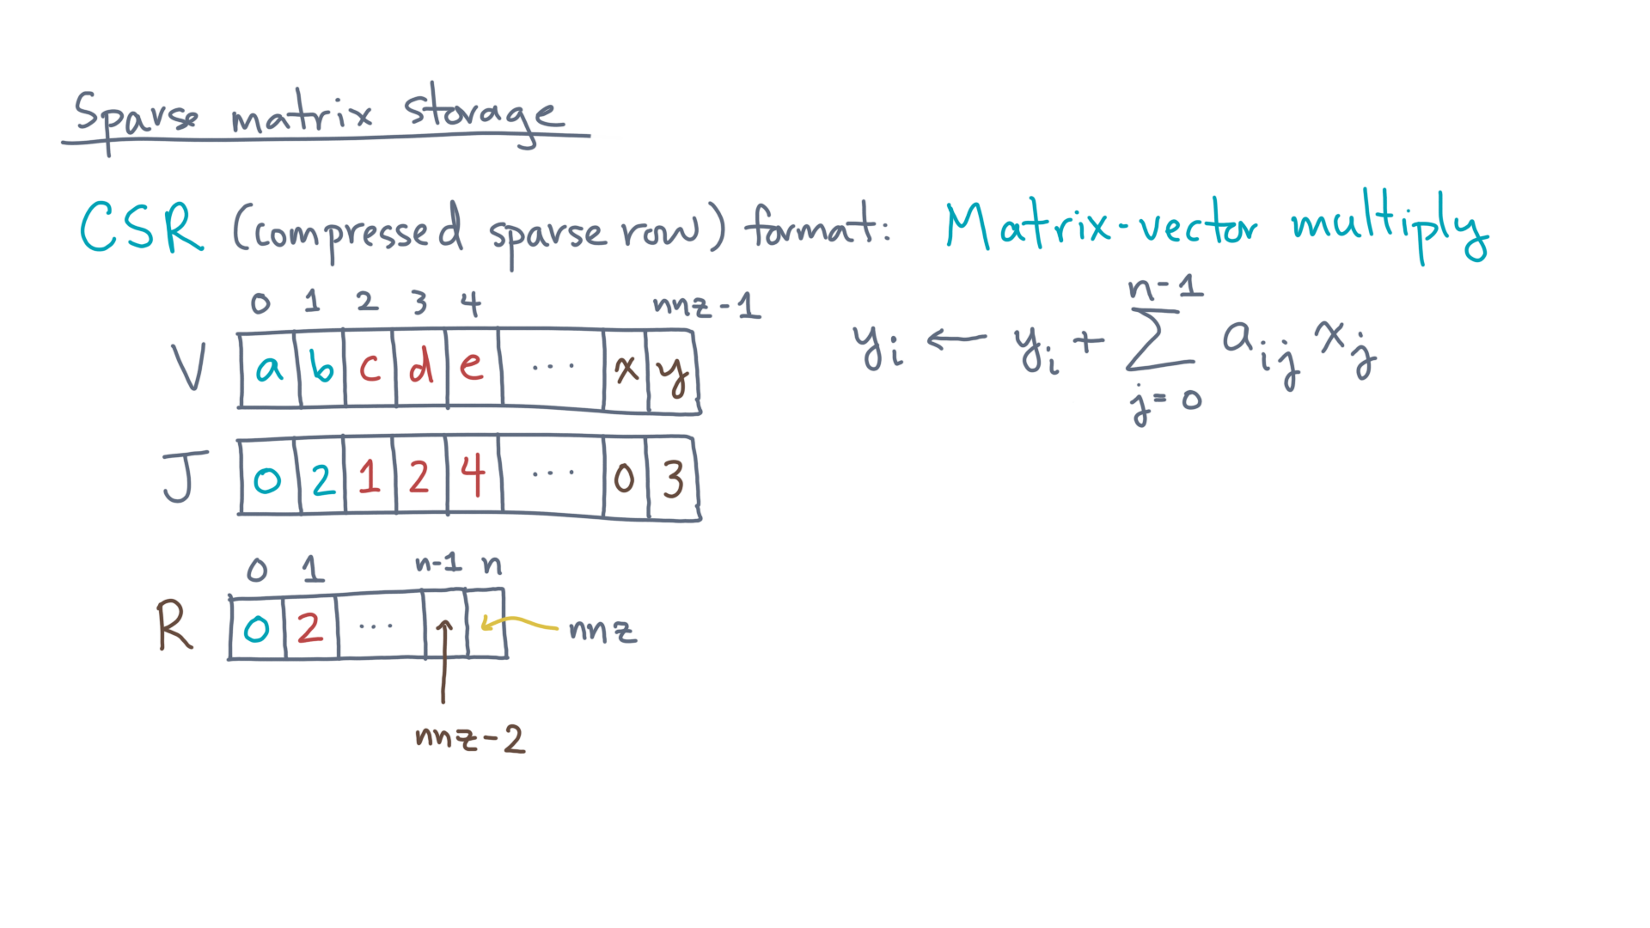
Notes:
So what does sparse matrix-vector multiply look like for a CSR matrix?

Slide 35
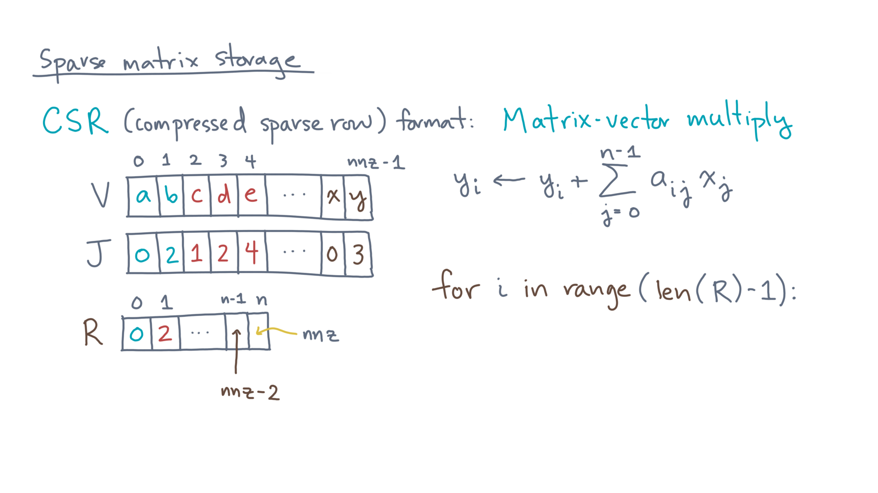
Notes:
Start by iterating over the row indices, 0 through n minus 1 inclusive.

Slide 36
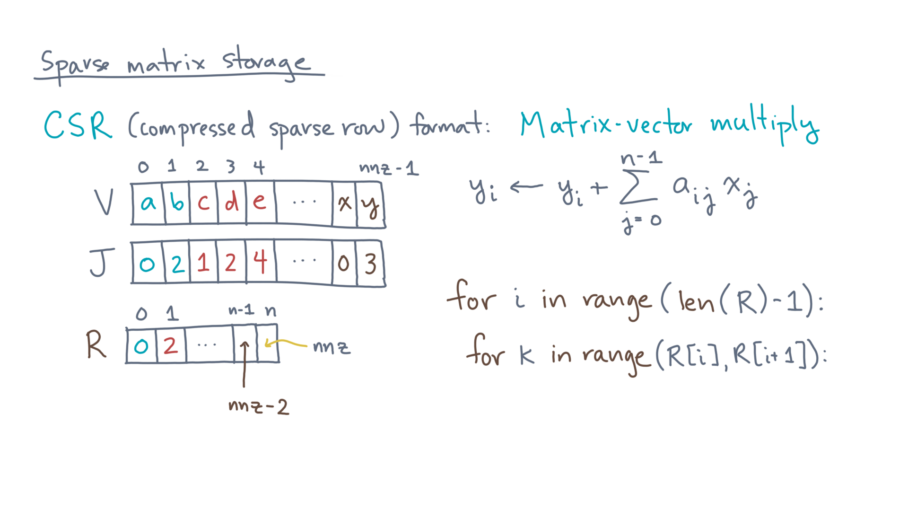
Notes:
Next, let’s iterate over the positions in capital-Vee and capital-Jay corresponding to row eye.
Call each position “kay.”

Slide 37
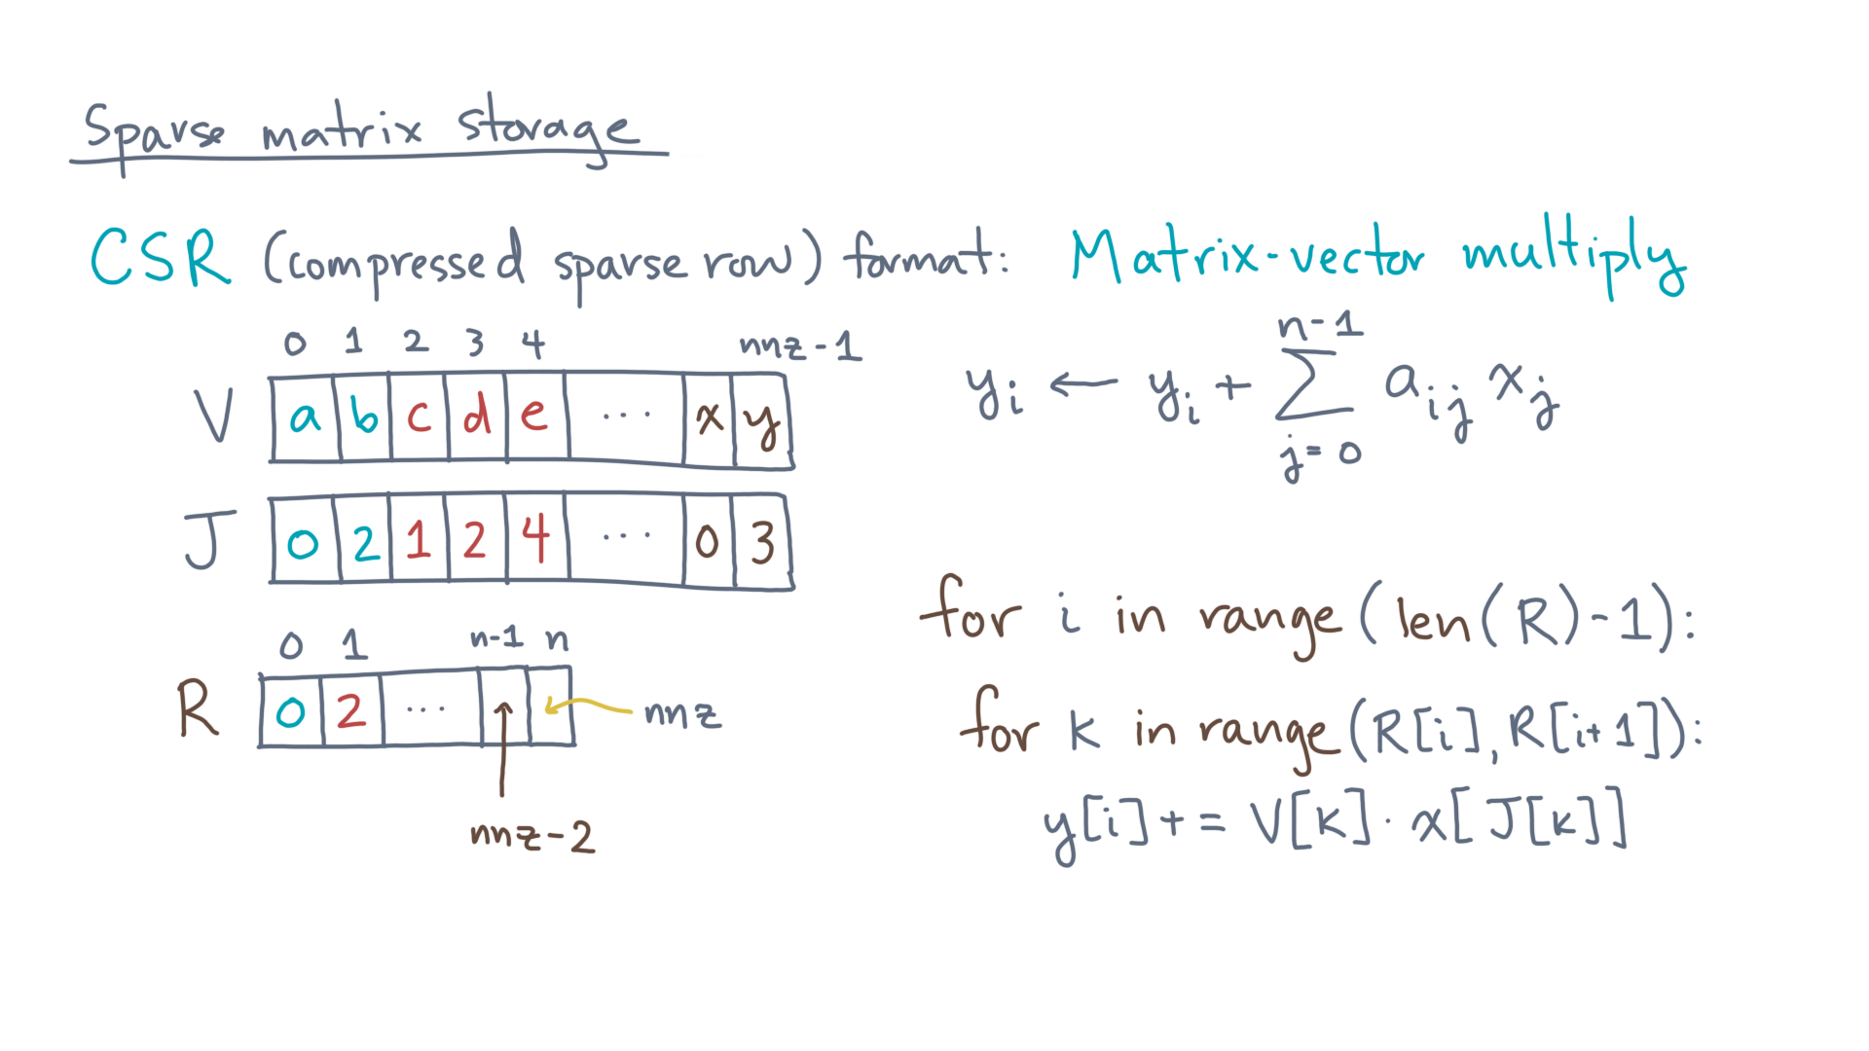
Notes:
Then the code can update y-sub-eye by the product big-Vee-sub-kay and x-sub-Jay-sub-kay.

Slide 38
Notes:
With that discussion of data structures for sparse matrices, you now have all the pieces you need to implement PageRank.
We’ve prepared a Jupyter notebook for you that asks you to apply a PageRank-style algorithm to a real graph, which is one representing the airline network in the United States.
I think you’ll find it to be fun. See you again soon!

